Slide 1
Chapter 6 Languages: Finite State Machines
謝孫源 講座教授
hsiehsy@mail.ncku.edu.tw
國立成功大學 資訊工程系

Slide 2
Outline
Language: The Set Theory of Strings
Finite State Machines: A First Encounter
Finite State Machines: A Second Encounter

Slide 3
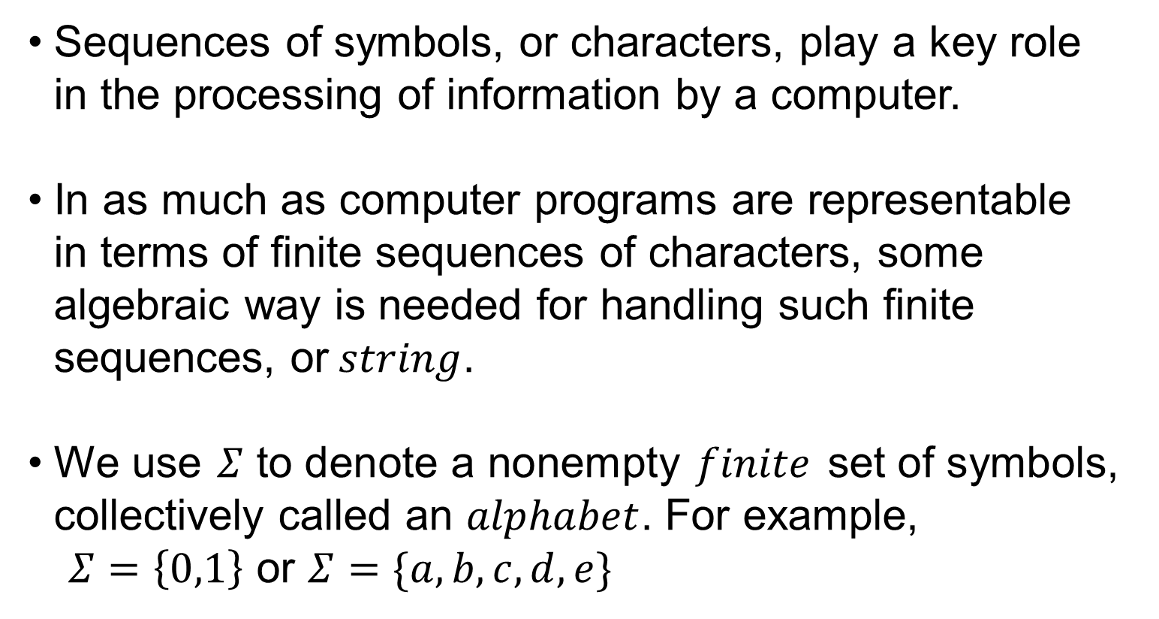
Language: The Set Theory of Strings(1/27)
Sequences of symbols, or characters, play a key role in the processing of information by a computer.
In as much as computer programs are representable in terms of finite sequences of characters, some algebraic way is needed for handling such finite sequences, or$string$.
We use $Σ$to denote a nonempty $finite$ set of symbols, collectively called an $alphabet$. For example,
$Σ=\left\{0,1\right\}$ or $Σ=\{a,b,c,d,e\}$

Slide 4
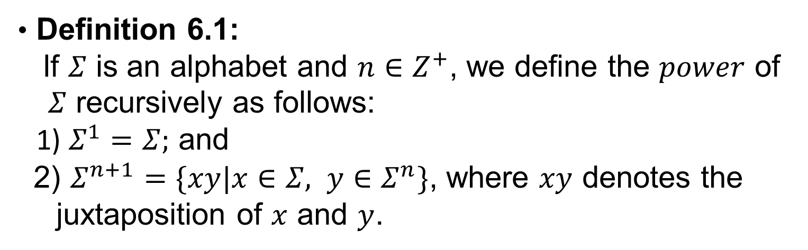
Language: The Set Theory of Strings(3/27)
Definition 6.1:
If $Σ$ is an alphabet and $n∈Z^{+}$, we define the $power$ of
$Σ$ recursively as follows:
1) $Σ^{1}=Σ;$ and
2) $Σ^{n+1}=\{xy|x∈Σ, y∈Σ^{n}\}$, where $xy$ denotes the
juxtaposition of $x$ and $y$.

Slide 5
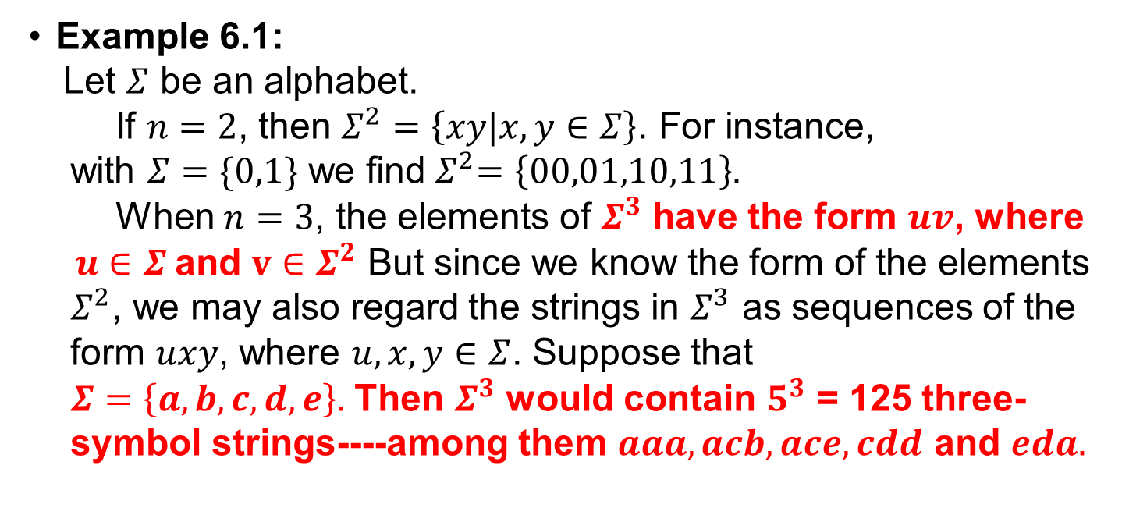
Language: The Set Theory of Strings(4/27)
Example 6.1:
Let $Σ$ be an alphabet.
If $n=2$, then $Σ^{2}=\left\{xy|x, y∈Σ\right\}$. For instance,
with $Σ=\{0,1\}$ we find${ Σ}^{2}=\left\{00,01,10,11\right\}.$
When $n=3$, the elements of $Σ^{3}$ have the form $uv$, where
$u∈Σ$and $v∈Σ^{2}$ But since we know the form of the elements
$Σ^{2}$, we may also regard the strings in $Σ^{3}$ as sequences of the
form $uxy$, where $u,x,y∈Σ$. Suppose that
$Σ=\left\{a,b,c,d,e\right\}.$ Then $Σ^{3}$ would contain $5^{3}$ = 125 three- symbol strings----among them $aaa,acb,ace,cdd$ and $eda.$

Slide 6
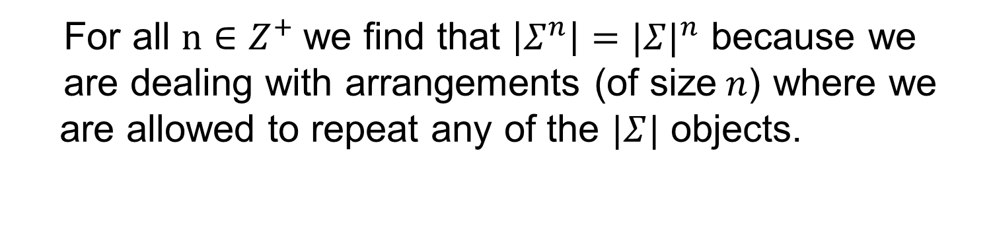
Language: The Set Theory of Strings(5/27)
For all $n∈Z^{+}$we find that $\left|Σ^{n}\right|={|Σ|}^{n}$ because we
are dealing with arrangements (of size$n$) where we are allowed to repeat any of the $|Σ|$ objects.

Slide 7
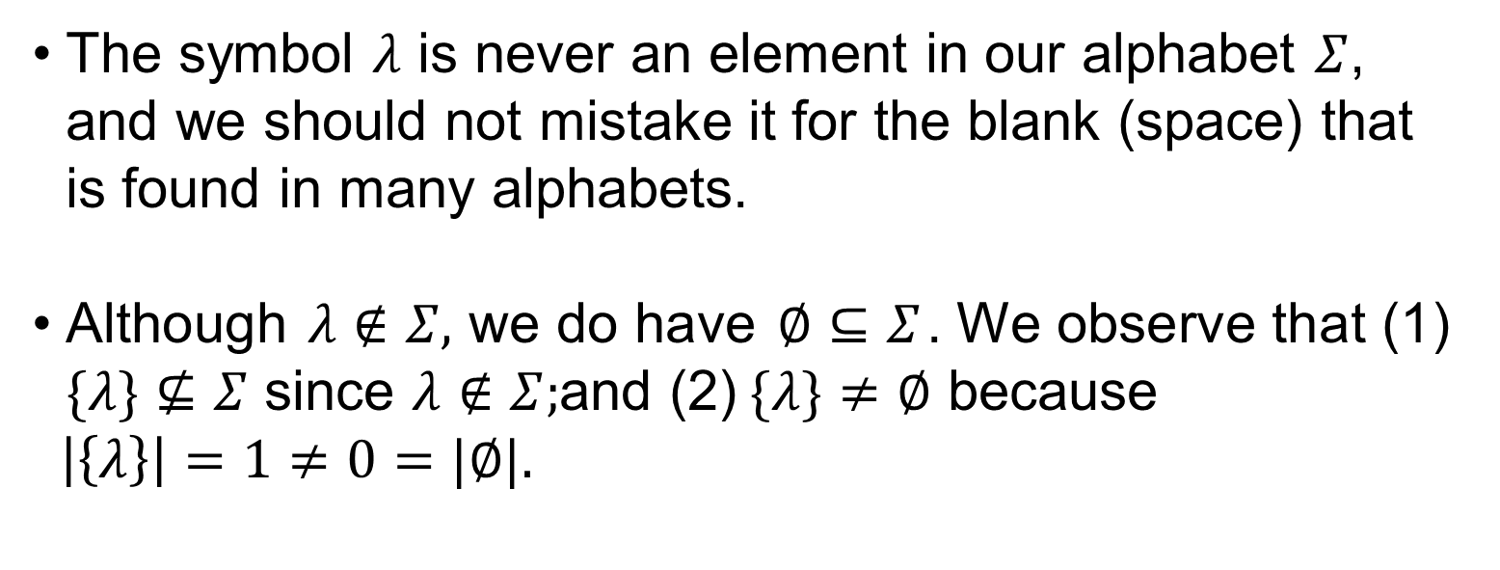
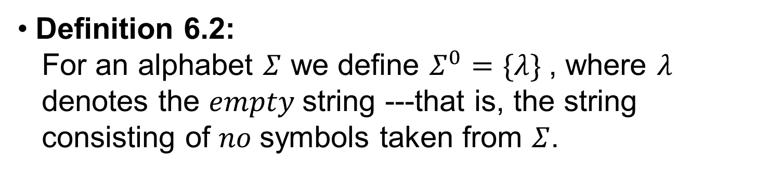
Language: The Set Theory of Strings(6/27)
Definition 6.2:
For an alphabet $Σ$ we define $Σ^{0}=\{λ\}$, where $λ$
denotes the $empty$string ---that is, the string
consisting of $no$symbols taken from $Σ$.
The symbol $λ$ is never an element in our alphabet $Σ$, and we should not mistake it for the blank (space) that is found in many alphabets.
Although $λ∉Σ,$we do have $∅⊆Σ$. We observe that (1) $\{λ\}⊈Σ$ since $λ∉Σ;$and (2)$\{λ\}≠∅$ because
$\left|\left\{λ\right\}\right|=1≠0=|∅|.$

Slide 8
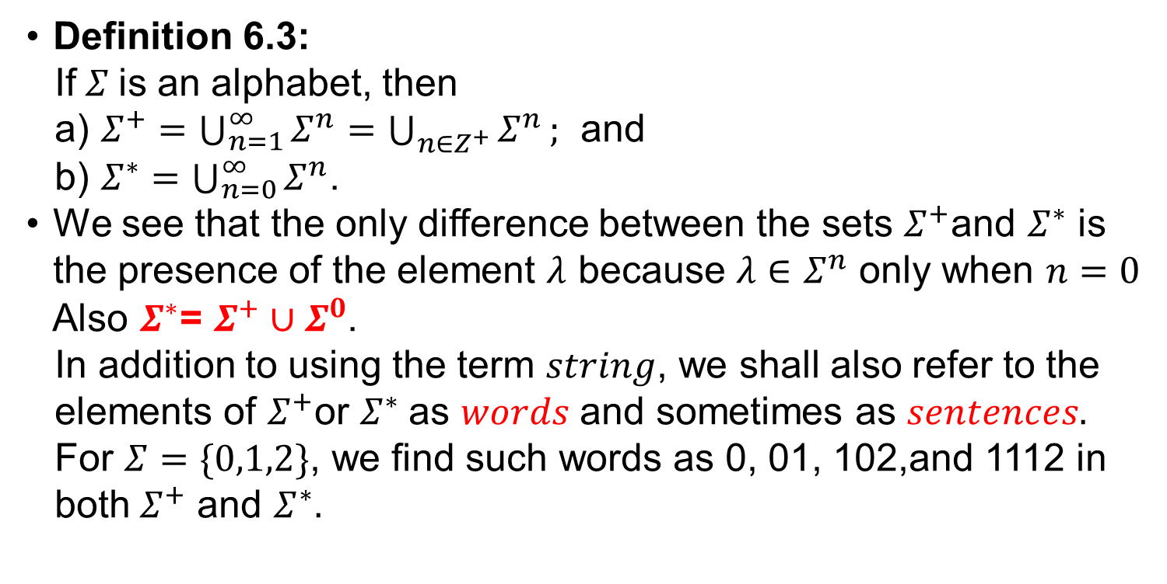
Language: The Set Theory of Strings(7/27)
Definition 6.3:
If$Σ$is an alphabet, then
a) $Σ^{+}=\bigcup_{n=1}^{∞}{Σ^{n}=\bigcup_{n∈Z^{+}}{Σ^{n}}};$ and
b) $Σ^{∗}=\bigcup_{n=0}^{∞}{Σ^{n}}$.
We see that the only difference between the sets $Σ^{+}$and $Σ^{∗}$ is the presence of the element $λ$ because $λ∈$ $Σ^{n}$ only when $n=0$
Also $Σ^{∗}$= $Σ^{+}∪Σ^{0}$.
In addition to using the term $string$, we shall also refer to the
elements of $Σ^{+}$or $Σ^{∗}$as $words$ and sometimes as $sentences.$
For $Σ=\{0,1,2\}$, we find such words as 0, 01, 102,and 1112 in
both${ Σ}^{+}$ and $Σ^{∗}.$

Slide 9
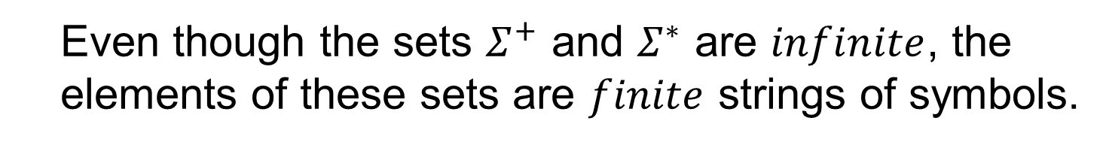
Language: The Set Theory of Strings(8/27)
Even though the sets $Σ^{+}$ and $Σ^{∗}$ are $infinite$, the
elements of these sets are $finite$ strings of symbols.

Slide 10
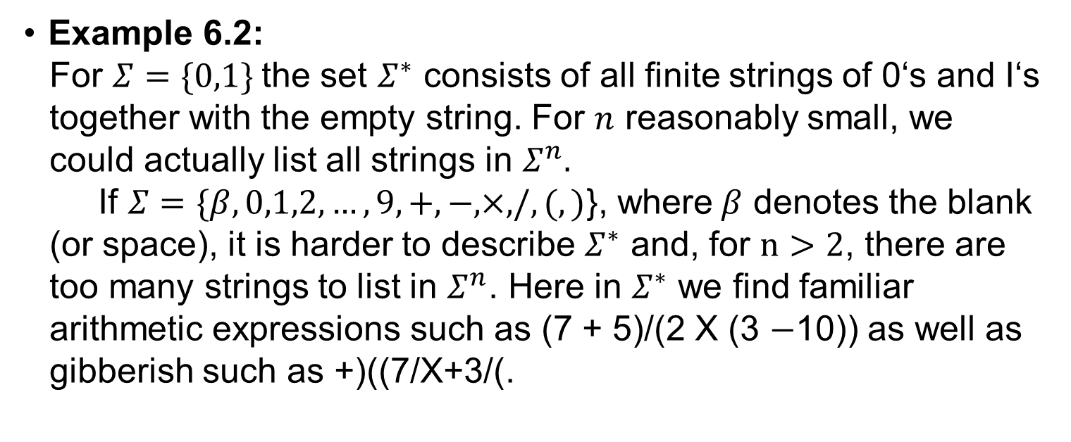
Language: The Set Theory of Strings(9/27)
Example 6.2:
For $Σ=\{0,1\}$the set $Σ^{∗}$ consists of all finite strings of 0‘s and I‘s
together with the empty string. For $n$ reasonably small, we
could actually list all strings in $Σ^{n}.$
If $Σ=\{β,0,1,2,…,9,+,−,×,/,(,)$}, where$β$ denotes the blank
(or space), it is harder to describe $Σ^{∗}$ and, for $n>2$, there are
too many strings to list in $Σ^{n}$. Here in $Σ^{∗}$ we find familiar
arithmetic expressions such as (7 + 5)/(2 X (3 $−$10)) as well as
gibberish such as +)((7/X+3/(.

Slide 11
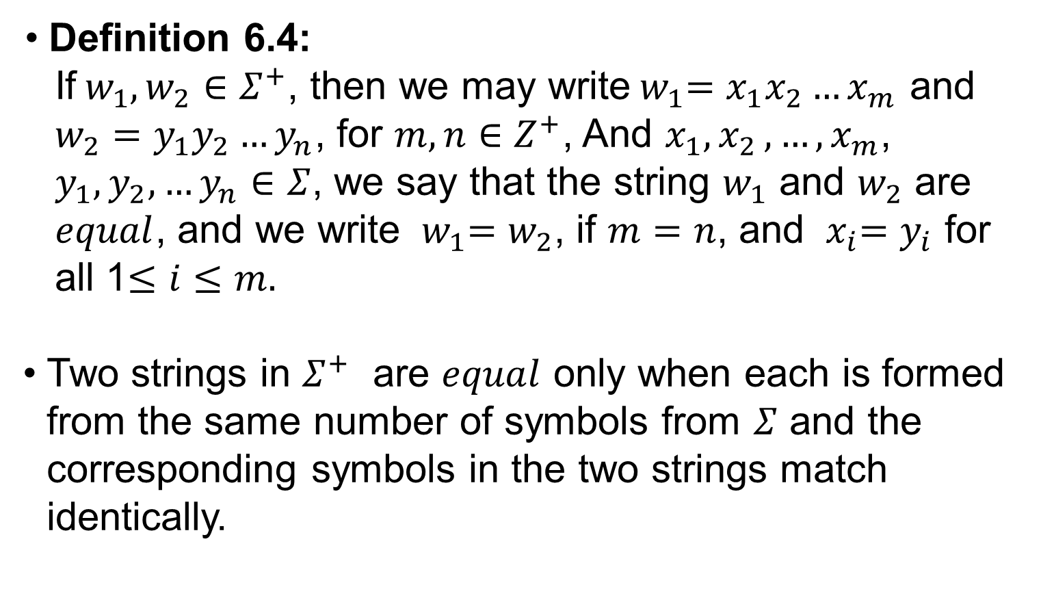
Language: The Set Theory of Strings(10/27)
Definition 6.4:
If${ w}_{1},w_{2}∈Σ^{+}$, then we may write${ w}_{1}=x_{1}x_{2}…x_{m}$ and
$w_{2}$ $=y_{1}y_{2}…y_{n}$, for $m,n∈Z^{+}$, And $x_{1}{,x}_{2},…,x_{m}$,
$y_{1},y_{2},…y_{n}$ $∈Σ$, we say that the string $w_{1}$ and $w_{2}$ are
$equal$, and we write ${ w}_{1}=w_{2}$, if $m=n$, and ${ x}_{i}=y_{i}$ for
all 1$≤i≤m.$
Two strings in $Σ^{+}$ are $equal$ only when each is formed from the same number of symbols from $Σ$ and the corresponding symbols in the two strings match identically.

Slide 12
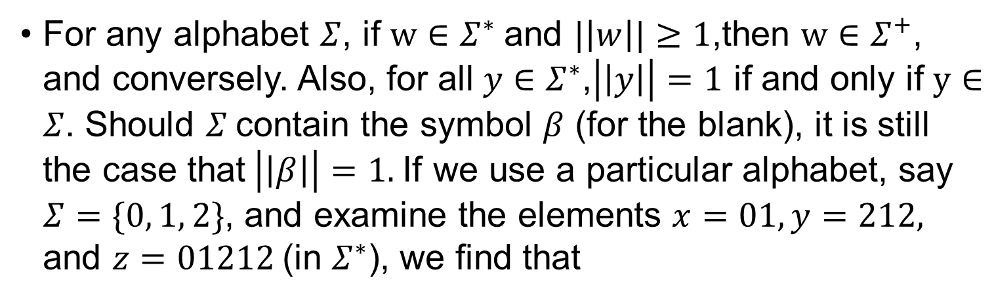
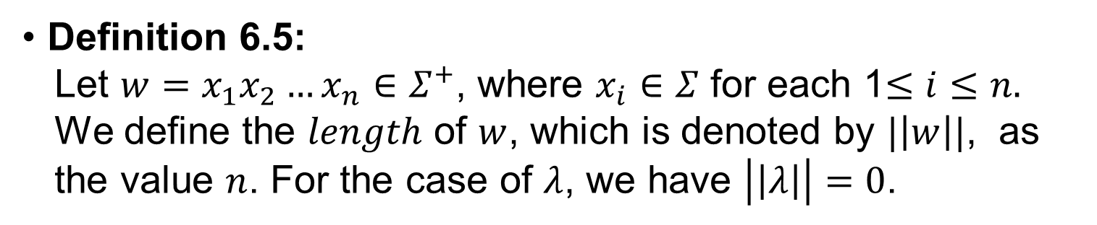
Language: The Set Theory of Strings(11/27)
Definition 6.5:
Let $w=x_{1}x_{2}…x_{n}∈Σ^{+}$, where $x_{i}∈Σ$ for each 1$≤i≤n.$
We define the $length$ of $w$, which is denoted by $|\left|w\right||$, as
the value $n$. For the case of $λ$, we have $\left|\left|λ\right|\right|=0$.
For any alphabet $Σ$, if $w∈Σ^{∗}$and $|\left|w\right||≥1$,then $w∈Σ^{+}$, and conversely. Also, for all $y∈Σ^{∗}$,$\left|\left|y\right|\right|=1$ if and only if $y∈Σ$. Should $Σ$contain the symbol $β$ (for the blank), it is still the case that$\left|\left|β\right|\right|=1.$If we use a particular alphabet, say $Σ=\{0, 1, 2\}$, and examine the elements $x=01,y=212,$ and $z=01212$(in $Σ^{∗}$), we find that

Slide 13
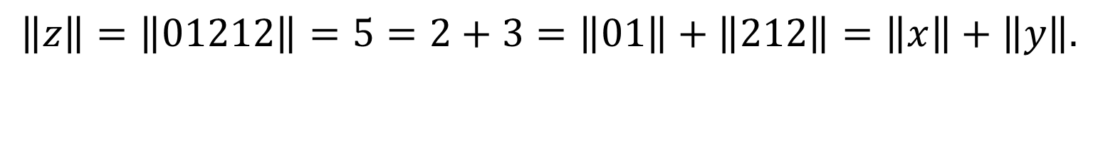
Language: The Set Theory of Strings(12/27)
$$\left\|z\right\|=\left\|01212\right\|=5=2+3=\left\|01\right\|+\left\|212\right\|=\left\|x\right\|+\left\|y\right\|.$$

Slide 14
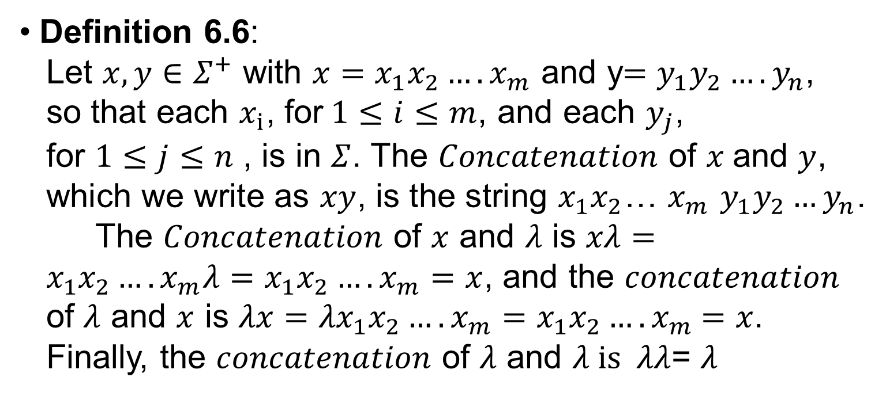
Language: The Set Theory of Strings(13/27)
Definition 6.6:
Let $x,y∈Σ^{+}$ with $x=x_{1}x_{2}….x_{m}$ and y$=y_{1}y_{2}….y_{n}$,
so that each $x_{i}$, for$1≤i≤m$, and each $y_{j}$,
for $1≤j≤n$ , is in $Σ$. The $Concatenation$ of $x$and $y$,
which we write as $xy$, is the string $x_{1}x_{2}$… $x_{m}$ $y_{1}y_{2}…y_{n}$.
The $Concatenation$ of $x$ and $λ$ is $xλ= x_{1}x_{2}….x_{m}λ=x_{1}x_{2}….x_{m}=x$, and the $concatenation$
of $λ$ and $x$ is $λx={λx}_{1}x_{2}….x_{m}=$ $x_{1}x_{2}….x_{m}$ $=x$.
Finally, the $concatenation$ of $λ$ and $λ is λλ$= $λ$

Slide 15
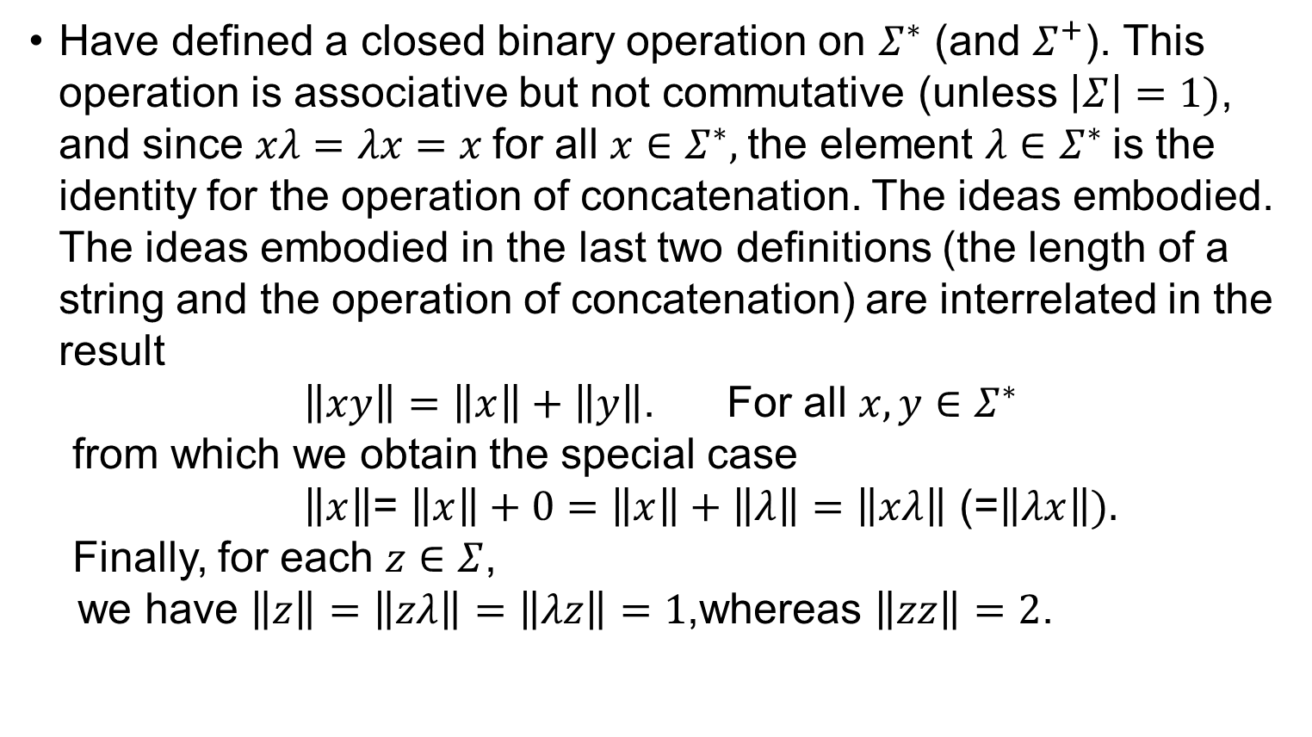
Language: The Set Theory of Strings (14/27)
Have defined a closed binary operation on $Σ^{∗}$ (and $Σ^{+}$). This operation is associative but not commutative (unless $\left|Σ\right|=1)$, and since $xλ=λx=x$for all $x∈Σ^{∗},$the element $λ∈Σ^{∗}$is the identity for the operation of concatenation. The ideas embodied. The ideas embodied in the last two definitions (the length of a string and the operation of concatenation) are interrelated in the result
$\left\|xy\right\|=\left\|x\right\|+\left\|y\right\|$. For all $x,y∈Σ^{∗}$
from which we obtain the special case
$\left\|x\right\|$= $\left\|x\right\|+0=\left\|x\right\|+\left\|λ\right\|=\left\|xλ\right\|\text{ (=}\left\|λx\right\|).$
Finally, for each $z∈Σ$,
we have $\left\|z\right\|=\left\|zλ\right\|=\left\|λz\right\|=1$,whereas $\left\|zz\right\|=2$.

Slide 16
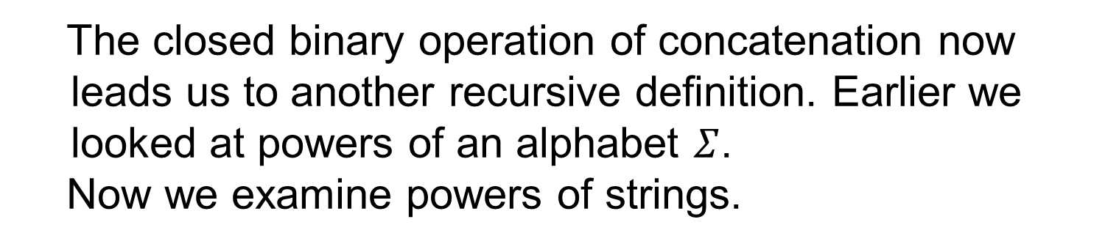
Language: The Set Theory of Strings(15/27)
The closed binary operation of concatenation now
leads us to another recursive definition. Earlier we
looked at powers of an alphabet $Σ$.
Now we examine powers of strings.

Slide 17
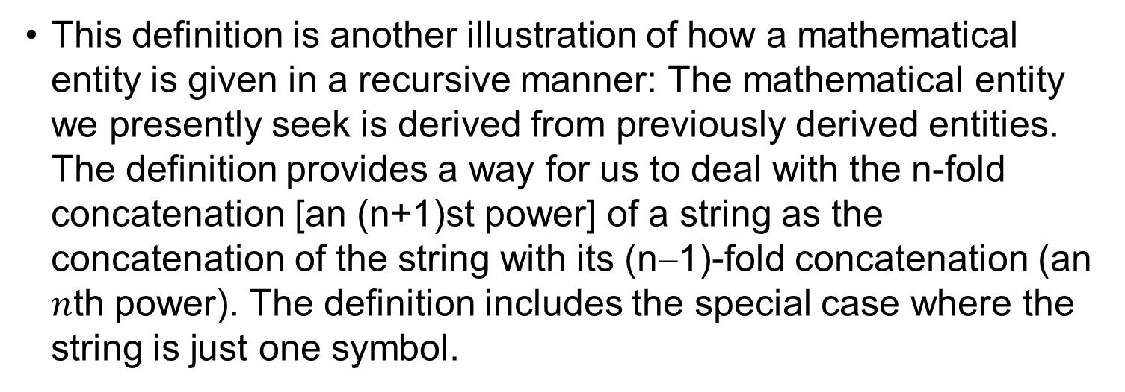
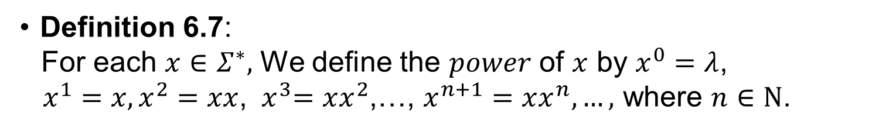
Language: The Set Theory of Strings(16/27)
Definition 6.7:
For each $x∈Σ^{∗},$ We define the $power$ of $x$ by $x^{0}=λ$,
$x^{1}=x,x^{2}=xx$, ${ x}^{3}=xx^{2}$,…, $x^{n+1}=xx^{n},…,$ where $n∈N$.
This definition is another illustration of how a mathematical entity is given in a recursive manner: The mathematical entity we presently seek is derived from previously derived entities. The definition provides a way for us to deal with the n-fold concatenation [an (n+1)st power] of a string as the concatenation of the string with its (n−1)-fold concatenation (an $n$th power). The definition includes the special case where the string is just one symbol.

Slide 18
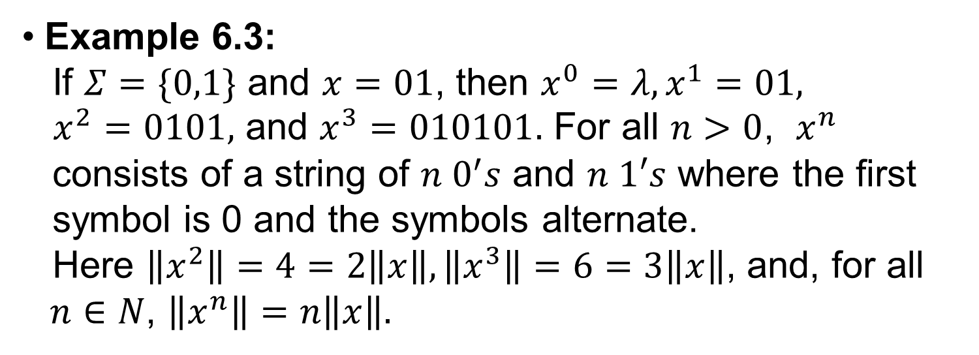
Language: The Set Theory of Strings(17/27)
Example 6.3:
If $Σ=\{0,1\}$ and $x=01$, then $x^{0}=λ,x^{1}=01,$
$x^{2}=0101,$ and $x^{3}=010101.$ For all $n>0$, $x^{n}$
consists of a string of $n 0^{′}s$ and $n 1′s$ where the first
symbol is 0 and the symbols alternate.
Here $\left\|x^{2}\right\|=4=2\left\|x\right\|,\left\|x^{3}\right\|=6=3\left\|x\right\|$, and, for all
$n∈N$, $\left\|x^{n}\right\|=n\left\|x\right\|.$

Slide 19
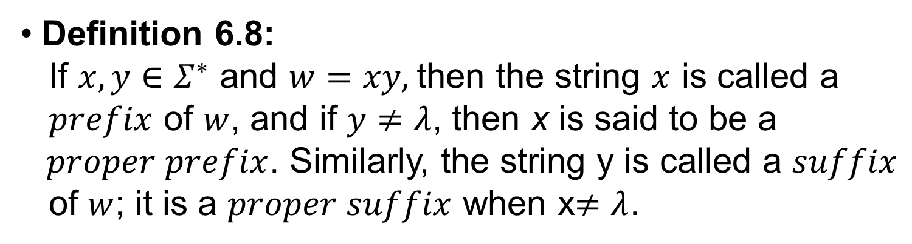
Language: The Set Theory of Strings(18/27)
Definition 6.8:
If $x,y∈Σ^{∗}$ and $w=xy,$then the string $x$ is called a
$prefix$ of $w$, and if $y≠λ$, then x is said to be a
$proper prefix$. Similarly, the string y is called a $suffix$
of $w$; it is a $proper suffix$ when x$≠λ$.

Slide 20
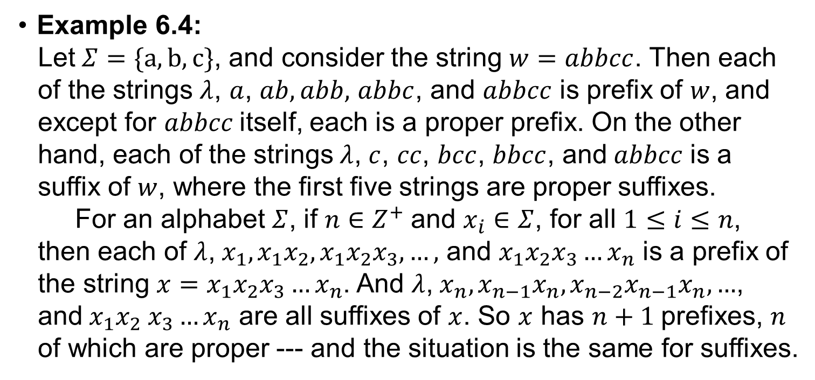
Language: The Set Theory of Strings(19/27)
Example 6.4:
Let$Σ=\{a,b,c\}$, and consider the string $w=abbcc$. Then each
of the strings $λ$, $a$, $ab,abb,$ $abbc$, and $abbcc$ is prefix of $w$, and
except for $abbcc$itself, each is a proper prefix. On the other
hand, each of the strings$λ$, $c$, $cc$, $bcc$, $bbcc$, and$abbcc$ is a
suffix of $w$, where the first five strings are proper suffixes.
For an alphabet $Σ$, if $n∈Z^{+}$and $x_{i}∈Σ$, for all $1≤i≤n$,
then each of $λ$,${ x}_{1},x_{1}x_{2},x_{1}x_{2}x_{3}, …,$ and $x_{1}x_{2}x_{3}…x_{n}$ is a prefix of
the string $x=x_{1}x_{2}x_{3}…x_{n}$. And $λ$,${ x}_{n},x_{n−1}x_{n},x_{n−2}x_{n−1}x_{n}, …$,
and${ x}_{1}x_{2} x_{3}…x_{n}$ are all suffixes of $x$. So $x$ has $n+1$prefixes, $n$
of which are proper --- and the situation is the same for suffixes.

Slide 21
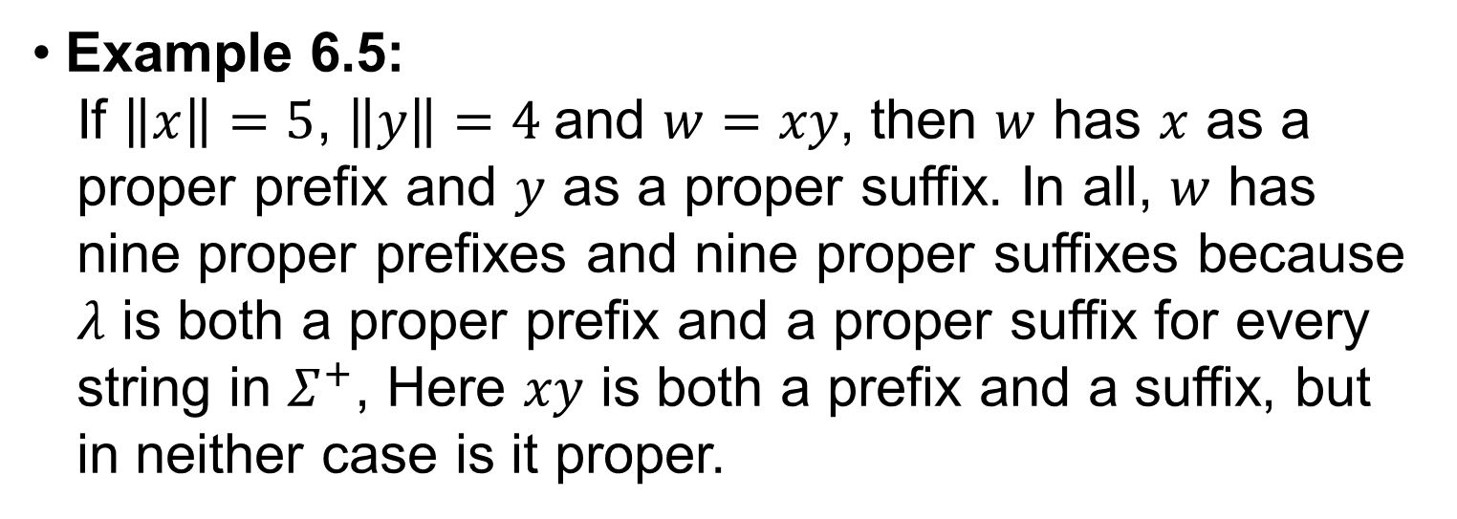
Language: The Set Theory of Strings(20/27)
Example 6.5:
If $\left\|x\right\|=5$, $\left\|y\right\|=4$and $w=xy$, then $w$ has $x$ as a
proper prefix and $y$ as a proper suffix. In all, $w$ has
nine proper prefixes and nine proper suffixes because
$λ$ is both a proper prefix and a proper suffix for every
string in $Σ^{+}$, Here $xy$ is both a prefix and a suffix, but
in neither case is it proper.

Slide 22
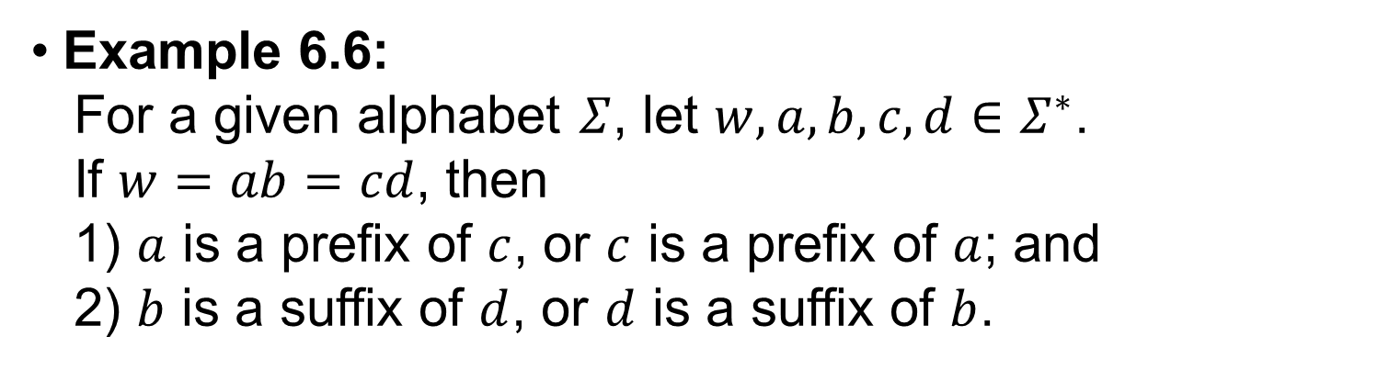
Language: The Set Theory of Strings(21/27)
Example 6.6:
For a given alphabet $Σ$, let $w, a, b, c, d∈Σ^{∗}$.
If $w=ab=cd$, then
1) $a$ is a prefix of $c$, or $c$ is a prefix of $a$; and
2) $b$ is a suffix of $d$, or $d$ is a suffix of $b$.

Slide 23
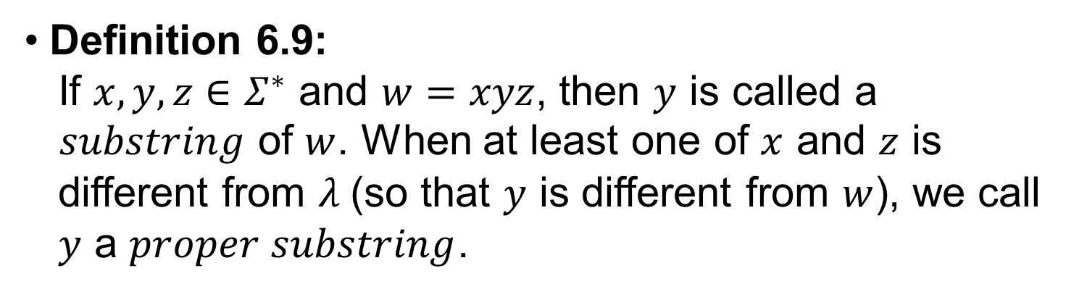
Language: The Set Theory of Strings(22/27)
Definition 6.9:
If $x, y, z∈Σ^{∗}$ and $w=xyz$, then $y$ is called a
$substring$ of $w$. When at least one of $x$ and $z$ is
different from $λ$(so that $y$ is different from $w$), we call
$y$ a $proper substring$.

Slide 24
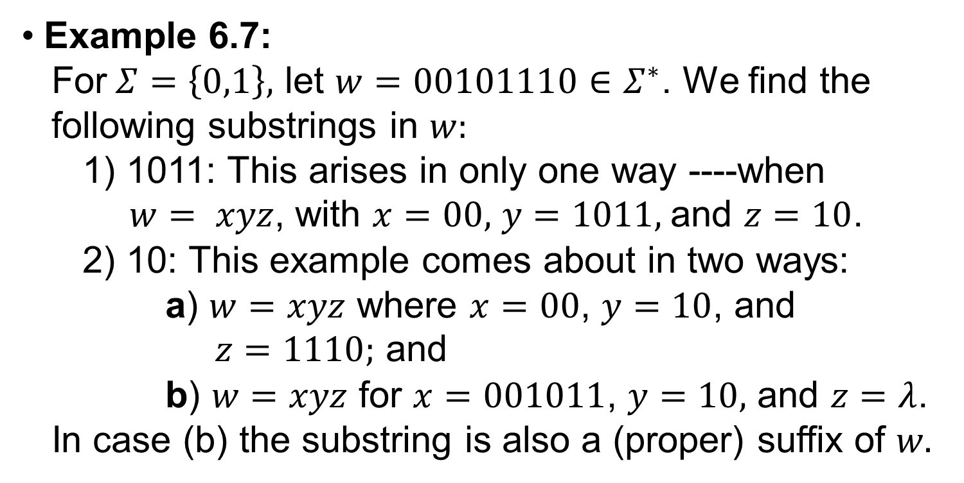
Language: The Set Theory of Strings(23/27)
Example 6.7:
For$Σ=\left\{0,1\right\},$ let $w=00101110∈Σ^{∗}$. We find the
following substrings in $w:$
1) 1011: This arises in only one way ----when
$w= xyz$, with $x=00,$ $y=1011,$and $z=10$.
2) 10: This example comes about in two ways:
a) $w=xyz$ where $x=00$, $y=10$, and
$z=1110;$ and
b) $w=xyz$ for $x=001011$, $y=10,$ and $z=λ$.
In case (b) the substring is also a (proper) suffix of $w.$

Slide 25
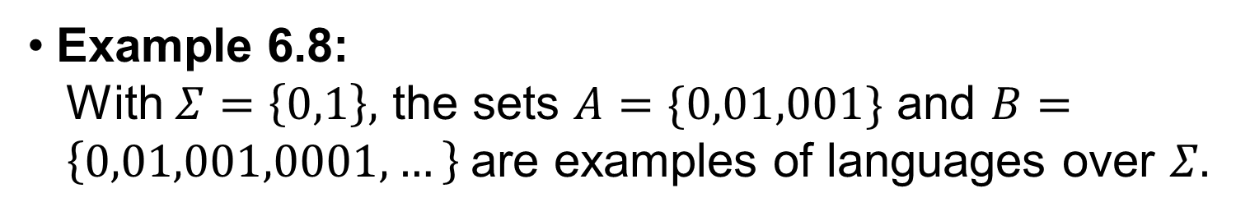
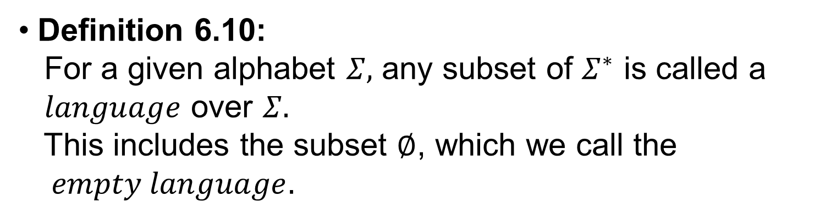
Language: The Set Theory of Strings(24/27)
Definition 6.10:
For a given alphabet $Σ,$ any subset of $Σ^{∗}$ is called a $language$ over $Σ.$
This includes the subset $∅$, which we call the $empty language.$
Example 6.8:
With $Σ=\left\{0,1\right\},$ the sets $A=\{0,01,001\}$ and $B= \left\{0,01,001,0001,…\right\}$are examples of languages over $Σ.$

Slide 26
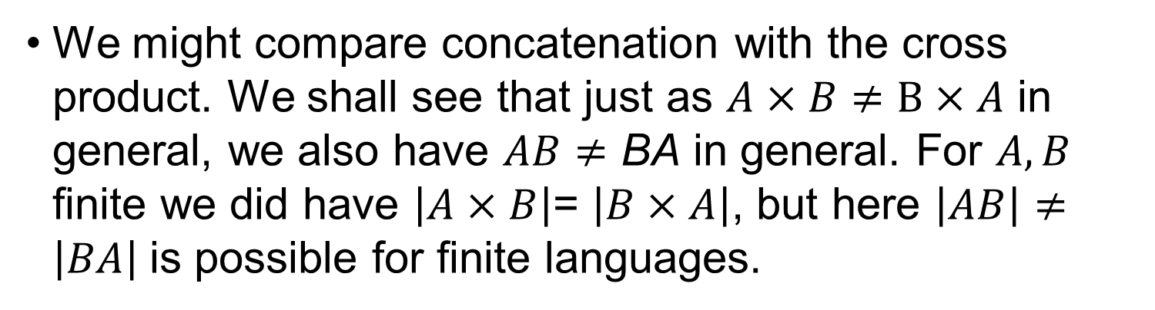
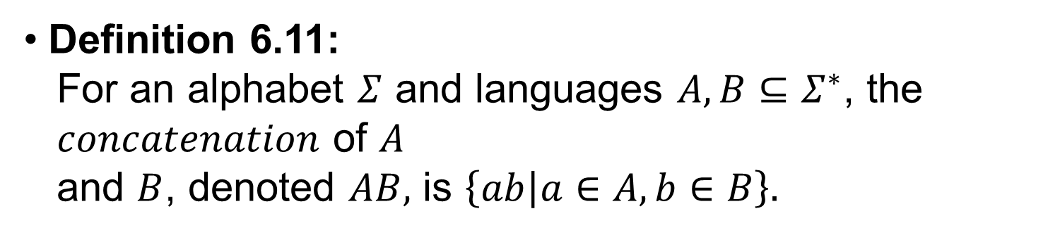
Language: The Set Theory of Strings(25/27)
Definition 6.11:
For an alphabet $Σ$ and languages $A, B⊆Σ^{∗}$, the $concatenation$ of $A$
and $B$, denoted $AB,$ is $\left\{ab | a∈A,b∈B\right\}.$
We might compare concatenation with the cross product. We shall see that just as $A×B≠B×A$ in general, we also have $AB≠$ BA in general. For $A, B$ finite we did have $\left|A×B\right|$= $\left|B×A\right|$, but here $\left|AB\right|≠\left|BA\right|$is possible for finite languages.

Slide 27
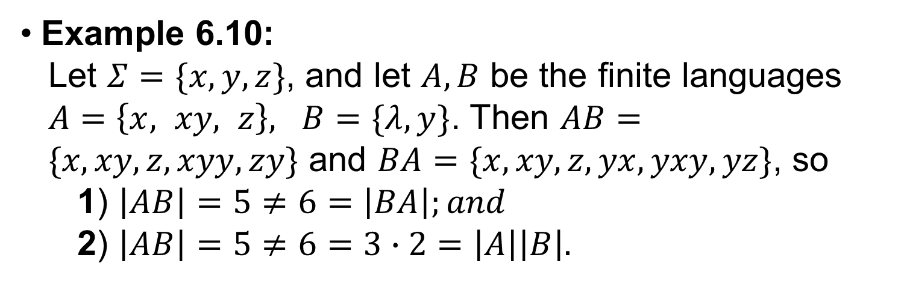
Language: The Set Theory of Strings(26/27)
Example 6.10:
Let $Σ=\{x,y,z\}$, and let $A, B$ be the finite languages $A=\left\{x, xy, z\right\}, B=\{λ,y\}$. Then $AB= \{x,xy,z,xyy,zy\}$ and $BA=\{x,xy,z,yx,yxy,yz\}$, so
1) $\left|AB\right|=5≠6=\left|BA\right|;and$
2) $\left|AB\right|=5≠6=3∙2=$ $\left|A\right|\left|B\right|.$

Slide 28
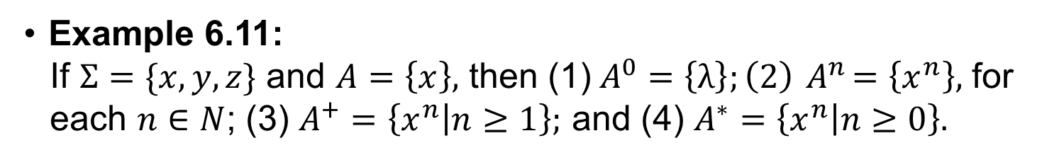
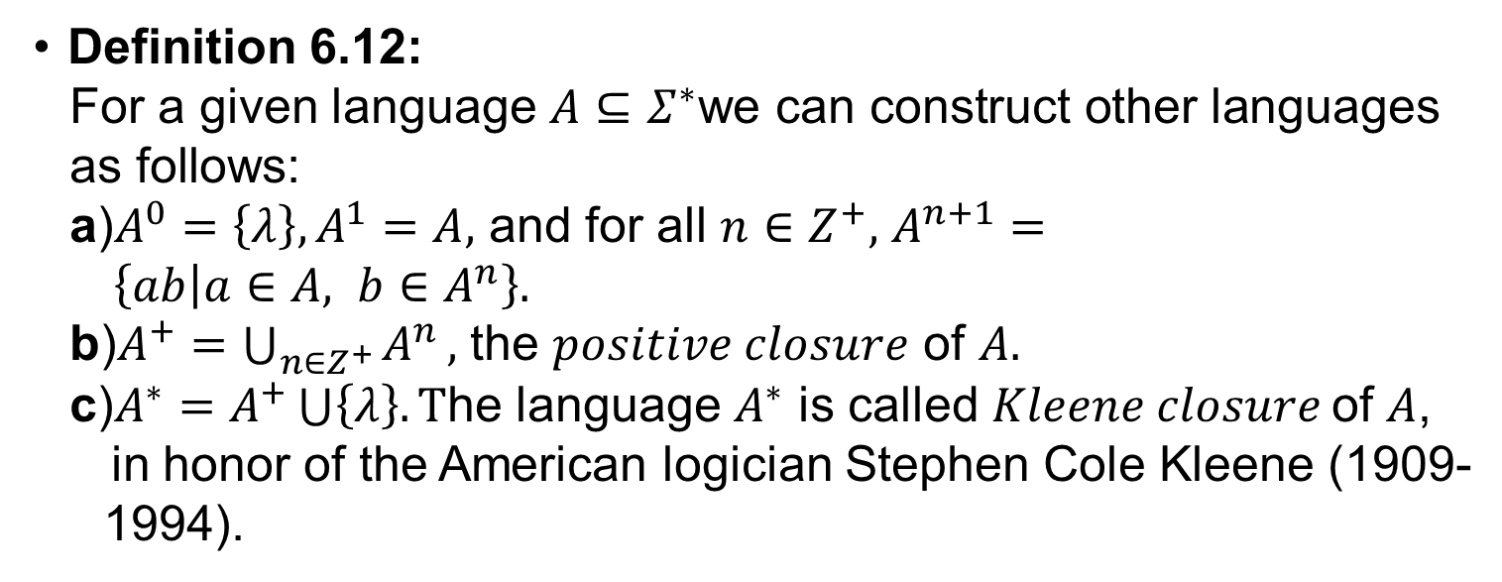
Language: The Set Theory of Strings(27/27)
Definition 6.12:
For a given language $A⊆Σ^{∗}\text{we} \text{can} \text{construct} \text{other} \text{languages} \text{as} \text{follows}\text{:}$
a)$A^{0}=\left\{λ\right\},A^{1}=A,$ and for all $n∈Z^{+},$ $A^{n+1}= \left\{ab | a∈A, b∈A^{n}\right\}.$
b)$A^{+}=\bigcup_{n∈Z^{+}}{A^{n}},$ the $positive closure$ of $A.$
c)$A^{∗}=A^{+}\bigcup{\left\{λ\right\}.}T$he language $A^{∗}$ is called $Kleene closure$of $A$,
in honor of the American logician Stephen Cole Kleene (1909- 1994).
Example 6.11:
If $Σ=\{x,y,z\}$ and $A=\left\{x\right\},$ then (1)$A^{0}=\left\{λ\right\};\left(2\right){ A}^{n}=\left\{x^{n}\right\},$ for
each $n∈N$; (3) $A^{+}=\left\{x^{n} | n≥1\right\};$ and (4) $A^{∗}=\left\{x^{n} | n≥0\right\}.$

Slide 29
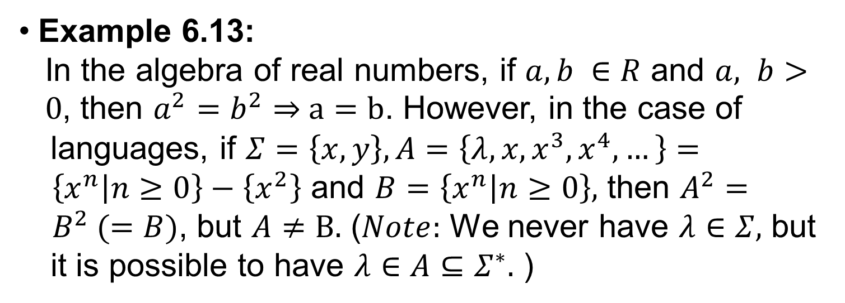
Language: The Set Theory of Strings(27/27)
Example 6.13:
In the algebra of real numbers, if $a, b ∈R$ and $a, b> 0$, then $a^{2}=b^{2}⇒$ $a=b$. However, in the case of languages, if $Σ=\left\{x,y\right\}, A=\left\{λ,x,x^{3},x^{4},…\right\}= \left\{x^{n} | n≥0\right\}−\left\{x^{2}\right\}$ and $B=\left\{x^{n} | n≥0\right\},$ then $A^{2}={ B}^{2} (=B)$, but $A≠B.$ ($Note:$ We never have $λ∈Σ,$ but it is possible to have $λ∈A⊆Σ^{∗}.$ )

Slide 30
Outline
Language: The Set Theory of Strings
Finite State Machines: A First Encounter
Finite State Machines: A Second Encounter

Slide 31
Finite State Machines: A First Encounter(1/27)
At a metropolitan office, a vending machine dispenses two flavors of chewing gum (each favor in a package of five pieces): peppermint (P) and spearmint (S). The cost of a package of either flavor is 20c. The machine accepts nickels, dimes, and quarters and returns the necessary change.

Slide 32
Finite State Machines: A First Encounter(2/27)
One day Mary Jo decides she‘d like a package of
peppermint-flavored chewing gun. She goes to the
vending machine, inserts two nickels and a dime, in
that order, and presses the white button, denoted W.
Out comes her package of peppermint-flavored
chewing gum. (To get a package of spearmint-flavored
chewing gum one presses the black button, denoted B.)

Slide 33
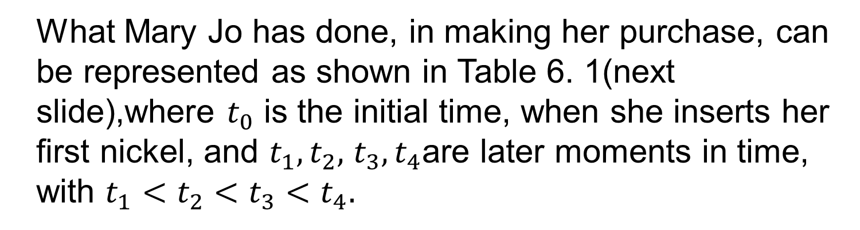
Finite State Machines: A First Encounter(3/27)
What Mary Jo has done, in making her purchase, can
be represented as shown in Table 6. 1(next
slide),where $t_{0}$ is the initial time, when she inserts her
first nickel, and $t_{1},t_{2},$ $t_{3}{,t}_{4}$are later moments in time,
with $t_{1}<t_{2}<t_{3}<t_{4}.$

Slide 34
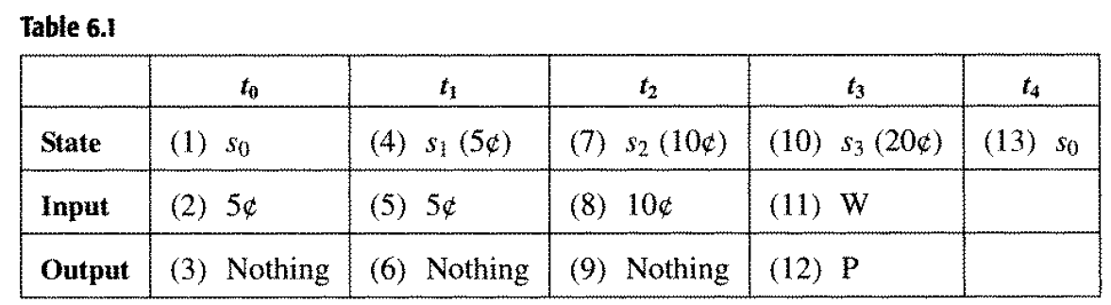
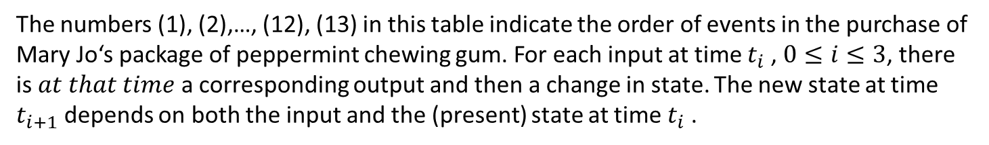
Finite State Machines: A First Encounter(4/27)
The numbers (1), (2),…, (12), (13) in this table indicate the order of events in the purchase of Mary Jo‘s package of peppermint chewing gum. For each input at time $t_{i}$ , $0≤i≤3$, there is $at that time$a corresponding output and then a change in state. The new state at time $t_{i+1}$ depends on both the input and the (present) state at time $t_{i}$ .

Slide 35
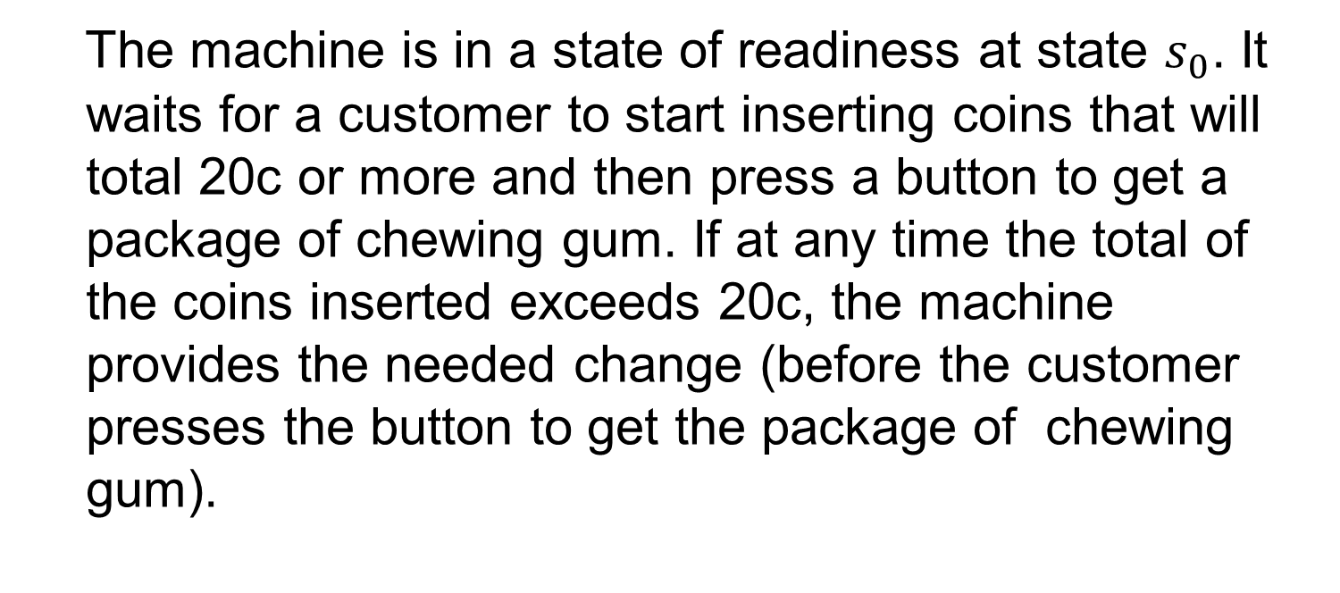
Finite State Machines: A First Encounter(5/27)
The machine is in a state of readiness at state $s_{0}$. It
waits for a customer to start inserting coins that will
total 20c or more and then press a button to get a
package of chewing gum. If at any time the total of
the coins inserted exceeds 20c, the machine
provides the needed change (before the customer
presses the button to get the package of chewing
gum).

Slide 36
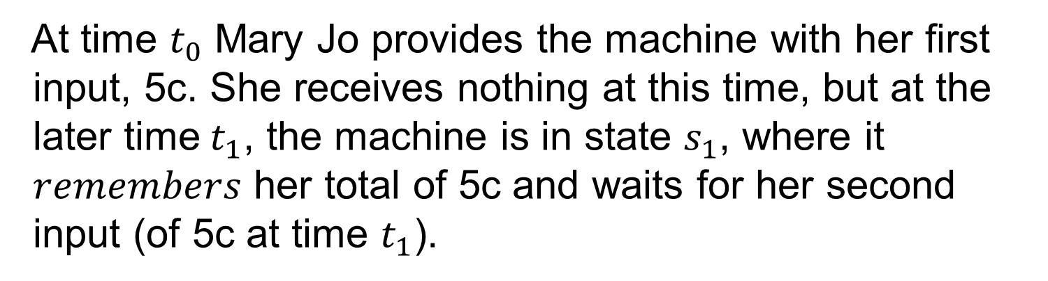
Finite State Machines: A First Encounter(6/27)
At time $t_{0}$ Mary Jo provides the machine with her first
input, 5c. She receives nothing at this time, but at the
later time$t_{1}$, the machine is in state $s_{1}$, where it
$remembers$ her total of 5c and waits for her second
input (of 5c at time $t_{1}$).

Slide 37
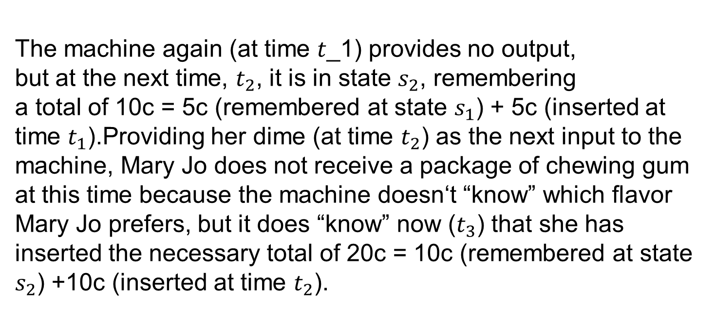
Finite State Machines: A First Encounter(7/27)
The machine again (at time 𝑡_1) provides no output,
but at the next time, $t_{2}$, it is in state $s_{2}$, remembering
a total of 10c = 5c (remembered at state $s_{1}$) + 5c (inserted at time $t_{1}$).Providing her dime (at time $t_{2}$) as the next input to the machine, Mary Jo does not receive a package of chewing gum at this time because the machine doesn‘t “know” which flavor Mary Jo prefers, but it does “know” now ($t_{3}$) that she has inserted the necessary total of 20c = 10c (remembered at state $s_{2}$) +10c (inserted at time $t_{2}$).

Slide 38
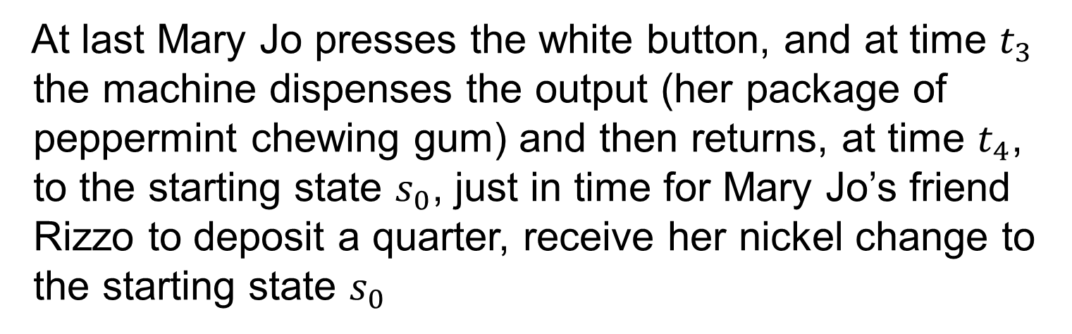
Finite State Machines: A First Encounter(8/27)
At last Mary Jo presses the white button, and at time $t_{3}$
the machine dispenses the output (her package of
peppermint chewing gum) and then returns, at time $t_{4}$,
to the starting state $s_{0}$, just in time for Mary Jo’s friend
Rizzo to deposit a quarter, receive her nickel change to
the starting state $s_{0}$

Slide 39
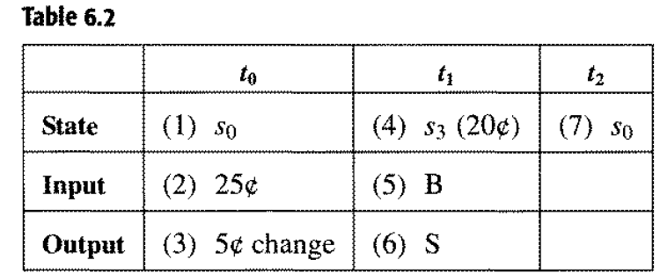
Finite State Machines: A First Encounter(9/27)
just in time for Mary Jo‘s friend Rizzo to deposit a
quarter, receive her nickel change, press the black
button, and obtain the package of spearmint chewing
gum she desires. The purchase made by Rizzo is
analyzed in Table 6.2.

Slide 40
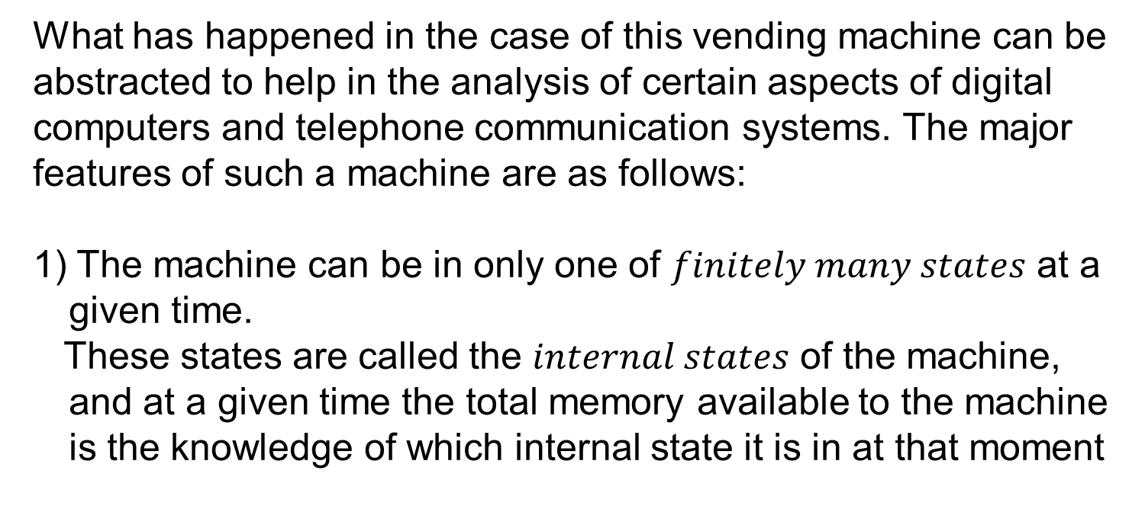
Finite State Machines: A First Encounter(10/27)
What has happened in the case of this vending machine can be
abstracted to help in the analysis of certain aspects of digital
computers and telephone communication systems. The major
features of such a machine are as follows:
1) The machine can be in only one of $finitely many states$ at a given time.
These states are called the $internal states$ of the machine, and at a given time the total memory available to the machine is the knowledge of which internal state it is in at that moment

Slide 41
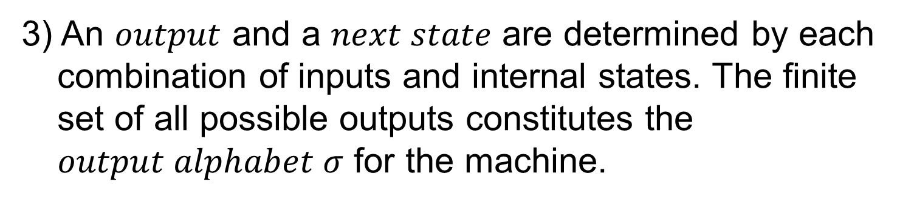
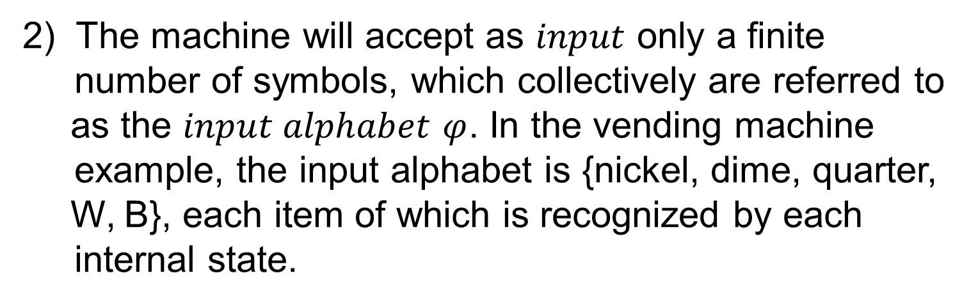
Finite State Machines: A First Encounter(11/27)
2) The machine will accept as $input$ only a finite
number of symbols, which collectively are referred to as the $input alphabet$ $φ$. In the vending machine
example, the input alphabet is {nickel, dime, quarter, W, B}, each item of which is recognized by each
internal state.
3) An $output$ and a $next state$ are determined by each combination of inputs and internal states. The finite set of all possible outputs constitutes the $output alphabet σ$ for the machine.

Slide 42
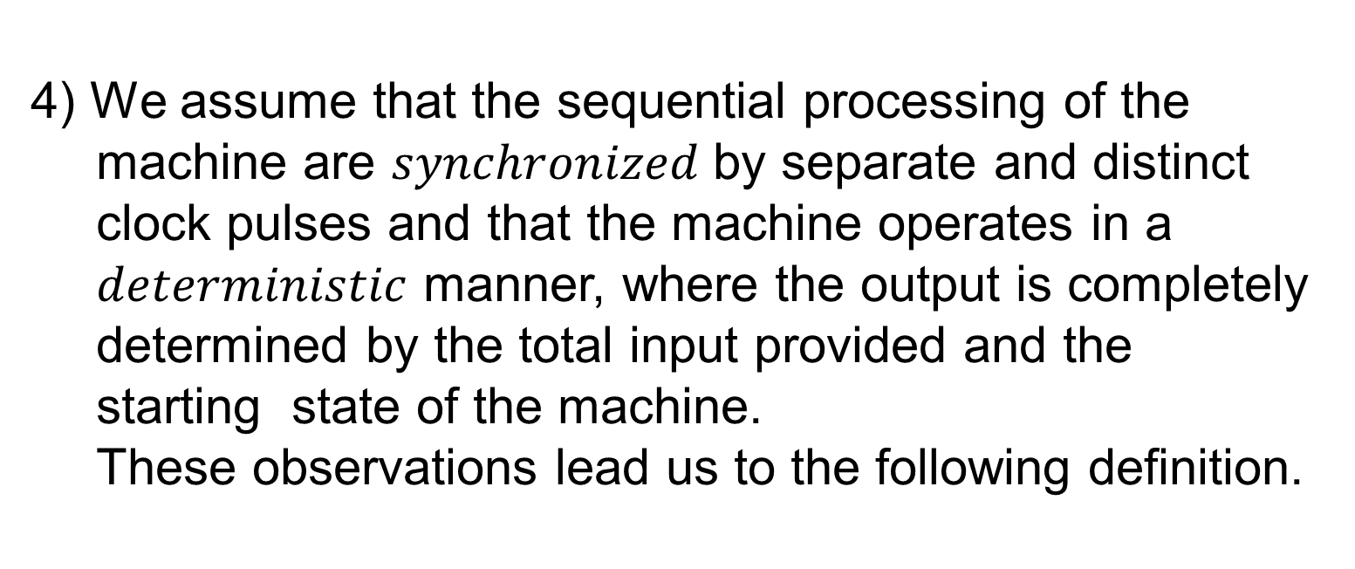
Finite State Machines: A First Encounter(12/27)
4) We assume that the sequential processing of the machine are $synchronized$by separate and distinct clock pulses and that the machine operates in a $deterministic$ manner, where the output is completely determined by the total input provided and the starting state of the machine.
These observations lead us to the following definition.

Slide 43
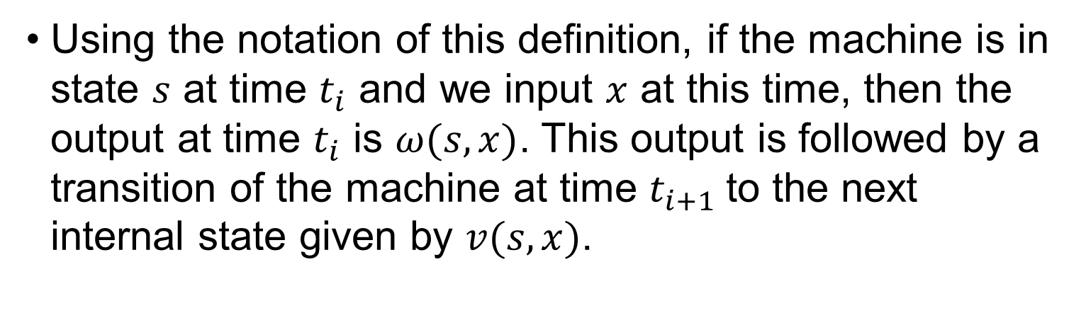
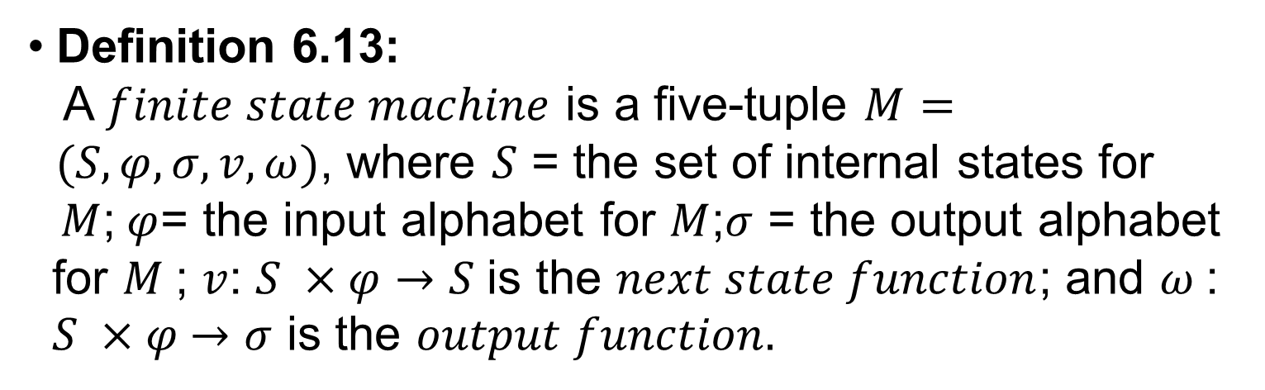
Finite State Machines: A First Encounter(13/27)
Definition 6.13:
A $finite state machine$ is a five-tuple $M= (S,φ,σ,v,ω)$, where $S$ = the set of internal states for
$M$;$φ$= the input alphabet for $M$;$σ$ = the output alphabet
for $M$; $v$: $S ×φ→S$is the $next state function$; and $ω$:
$S ×φ$ $→σ$ is the $output function.$
Using the notation of this definition, if the machine is in state $s$ at time $t_{i}$ and we input $x$ at this time, then the output at time $t_{i}$ is $ω(s,x)$. This output is followed by a transition of the machine at time $t_{i+1}$to the next internal state given by $v(s,x)$.

Slide 44
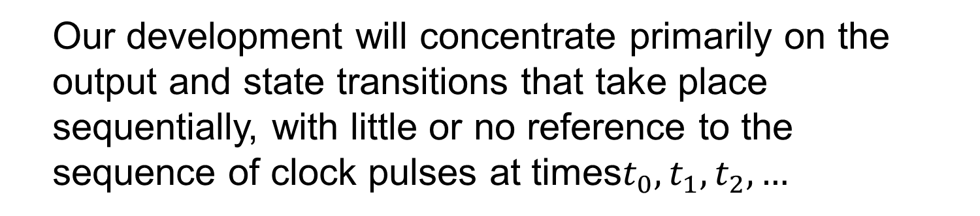
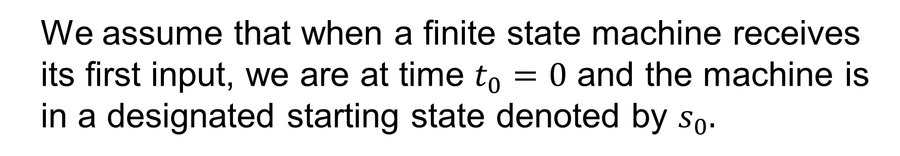
Finite State Machines: A First Encounter(14/27)
We assume that when a finite state machine receives
its first input, we are at time $t_{0}=0$ and the machine is
in a designated starting state denoted by $s_{0}.$
Our development will concentrate primarily on the
output and state transitions that take place
sequentially, with little or no reference to the
sequence of clock pulses at times$t_{0},t_{1},t_{2},…$

Slide 45
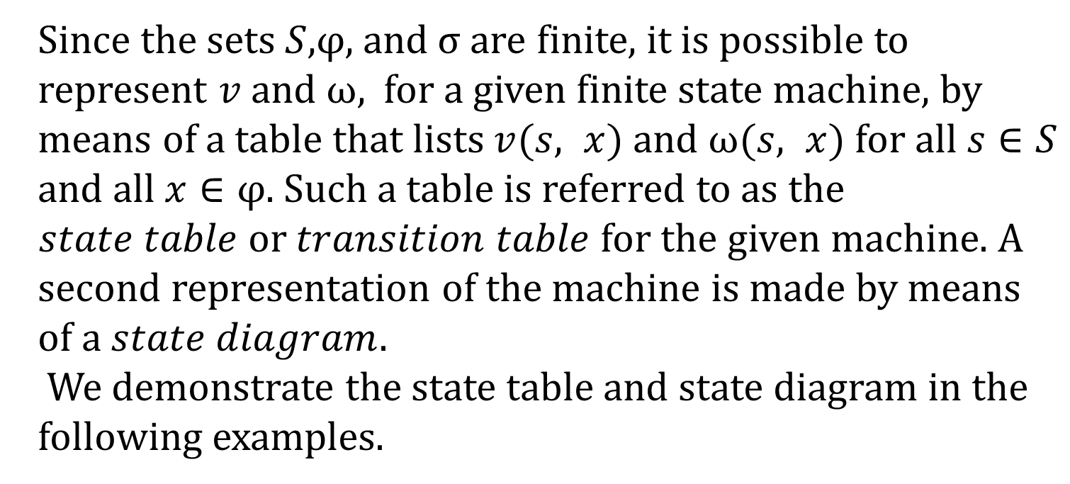
Finite State Machines: A First Encounter(15/27)
Since the sets $S$,$φ$, and$σ$are finite, it is possible to
represent $v$ and $ω$, for a given finite state machine, by
means of a table that lists $v(s, x)$ and $ω(s, x)$for all $s∈S$
and all $x∈φ$. Such a table is referred to as the
$state table$or $transition table$for the given machine. A
second representation of the machine is made by means
of a $state diagram.$
We demonstrate the state table and state diagram in the
following examples.

Slide 46

Finite State Machines: A First Encounter(16/27)
Example 6.17:
Consider the finite state machine $M=(S,φ,σ,v,ω)$, where $S= \{s_{0},s_{1},s_{2}\}$,$φ=σ=${0, 1}, and $v$, $ω$are given by the $state table$ in Table 6.3. The first column of the table lists the ($presents$) states for the machine. The entries in the second row are the elements of the input alphabet$φ$, Listed once under $v$ and then again under $ω$. The six numbers in the last two columns (and last three rows) are elements of the output alphabet$σ$

Slide 47


Finite State Machines: A First Encounter(17/27)
To calculate $v(s_{1},1)$, for example, we find $s_{1}$ in the column of present states and proceed horizontally over from $s_{1}$ until we are below the entry 1 in the section of the table for $v$. This entry gives $v$($s_{1}$, 1) = $s_{1}$. In the same way we find $ω\left(s_{1}\text{, 1}\right)=0$. With $s_{0}$ designated as the starting state, if the input provided to $M$ is the string 1010, then the output is 0010,

Slide 48


Finite State Machines: A First Encounter(18/27)
as demonstrated in Table 6.4. Here the machine is left in state $s_{2}$,so that if we had another input string, we would provide the first character of that string, here 0, at state $s_{2}$ unless the machine is $reset$ to start once again at $s_{0}$.

Slide 49

Finite State Machines: A First Encounter(19/27)
Since we are primarily interested in the output, not in the sequence of transition states, the same machine can be represented by means of a $state diagram$. Here we can obtain the output string without actually listing the transition states. In such a diagram each internal state $s$ is represented by a circle with $s$ inside of it. For states $s_{i}$ and $s_{j}$ , if $v(s_{i}, x) = s_{j}$ for $x∈φ$, and $ω$($s_{i}$ , $x) = y$for $y$ $∈σ$, we represent this in the state diagram by drawing a $directed edge$(or $arc)$ from the circle for $s_{i}$, to the circle for $s_{j}$; and labeling the arc with the input $x$ and output $y$ as shown in Fig. 6.1.

Slide 50


Finite State Machines: A First Encounter(20/27)
With these conventions, the state diagram for the machine $M$of Table 6.3 is shown in Fig. 6.2. Although the table is more compact, the diagram enables us to follow an input string through each transition state it determines, picking up each of the corresponding output symbols before each transition.

Slide 51

Finite State Machines: A First Encounter(21/27)
If the input string is 00110101, then starting at State $s_{0}$, the first input of 0 yields an output of 0 and returns us to $s_{0}$. The next input of 0 yields the same result, but for the third input, 1,the output is 0 and we are now in state $s_{1}$. Continuing in this manner, we arrive

Slide 52











Finite State Machines: A First Encounter(22/27)
at the output string 00000101 and finish in state $s_{1}$.
(We note that the input string 00110101 is an element
of$φ^{∗}$, the Kleene closure of$φ$, and that the output
string is in $σ^{∗}$, the Kleene closure of$σ$.) Starting at $s_{0}$,
what is the output string for the input string
1100101101?
$$0,0$$
$$1,0$$
$$1,0$$
$$0,0$$
Start
$$S_{0}$$
$$S_{1}$$
$$S_{2}$$
$$1,1$$
$$0,0$$

Slide 53


Finite State Machines: A First Encounter(23/27)
Example 6.19:
Let $x=x_{5}x_{4}x_{3}x_{2}x_{1}=00111$ and $y=y_{5}y_{4}y_{3}y_{2}y_{1}=01101$be binary numbers where $x_{1}$and $y_{1}$ are the least significant bits. The leading 0’s in $x$and $y$ are there to make the strings for $x$ and $y$ of equal length and to guarantee enough places to complete the sum. A $serial binary adder$is a finite state machine that we can use to obtain $x + y$. The diagram in Fig. 6.3 illustrates this, where $z=z_{5}z_{4}z_{3}z_{2}z_{1}$ has the least significant bit $z_{1}$.

Slide 54


Finite State Machines: A First Encounter(24/27)
In the addition $z=x+y$, we have
We note that for the first addition $x_{1}=y_{1}$ and $z_{1}=0$, whereas
for the third addition we have $x_{3}$ = $y_{3}=1$ and $z_{3}=1$ because of
a $carry$ from the addition of $x_{2}$ and $y_{2}$ (and the $carry$ from $x_{1}+{ y}_{1}$). Consequently, each output depends on the sum of two
inputs and the ability to $remember$ a carry of 0 or 1, which is
crucial when the carry is 1.

Slide 55


Finite State Machines: A First Encounter(25/27)
The serial binary adder is modeled by a finite state machine $M$ $=(S,φ,σ,v,ω)$ as follows. The set $S=\{s_{0},s_{1}\}$, where $s_{i}$ indicates a carry of $i;φ=\left\{00,01,10,11\right\}$, so there is a pair of inputs, depending on whether we are seeking $0 + 0, 0 + 1, 1 +0$, or $1 + 1$, respectively; and $σ=\{0,1\}$. The functions $v,ω$ are given in the state table (Table 6.6) and the state diagram(Fig. 6.4).

Slide 56

Finite State Machines: A First Encounter(26/27)
In Table 6.6 we find, for example, that $v\left(s_{1},01\right)=s_{1}$
and $ω$ $\left(s_{1},01\right)$= 0, because $s_{1}$ indicates a carry of 1
from the addition of the previous bits. The 01 input
indicates that we are adding 0 and 1 (and carrying a 1).
Hence the sum is 10 and $ω$ $\left(s_{1},01\right)=0$ for the 0 in 10.
The carry is again remembered in ${ s}_{1}$ = $v$ $\left(s_{1},01\right)$.
From the state diagram (Fig. 6.4) we see that the
starting state must be $s_{0}$because there is no carry
prior to the addition of the least significant bits.

Slide 57

Finite State Machines: A First Encounter(27/27)

Slide 58
Outline
Language: The Set Theory of Strings
Finite State Machines: A First Encounter
Finite State Machines: A Second Encounter

Slide 59

Finite State Machines: A Second Encounter(1/18)
Having seen some examples of finite state machines, we turn to the study of some additional machines that are relevant to the design of computer hardware. One important type of machine is the $sequence recognizer.$

Slide 60

Finite State Machines: A Second Encounter (2/18)
Example 6.20:
Here,$φ=σ=\{0,1\}$, and we want to construct a machine that recognizes each occurrence of the sequence 111 as it is encountered in an input string $x∈φ^{∗}$. For example, if $x=$1110101111, then the corresponding output should be 0010000011, where a 1 in the $i$th position of the output indicates that a 1 can be found in positions $i,$ $i −1$, and $i − 2$of $x$.Here overlapping of sequences of 111 can occur, so some characters in the input string can be thought of as characters in more than one triple of 1’s.

Slide 61

Finite State Machines: A Second Encounter (3/18)
Letting $s_{0}$denote the starting state, we realize that we must have a state to remember 1 (the possible start of 111) and a state to remember 11. In addition, any time our input symbol is 0, we go back to $s_{0}$ and start the search for three successive 1's over again.

Slide 62

Finite State Machines: A Second Encounter (4/18)
then a third "1” indicates the occurrence of the triple in
the input string, and the output 1 $recognizes$ this
occurrence. But this third “1'' also means that we have
the first two 1's of another possible triple coming up in
the string (as happens in 11101011 "1" 1). So after
recognizing the occurrence of 111 with an output of 1,
we return to state $s_{2}$ to remember the two inputs of 1
"1".

Slide 63


Finite State Machines: A Second Encounter (5/18)
If we are concerned with recognizing all strings that
end in 111, then for each $x∈φ^{∗},$ the machine will
recognize such a sequence with final output 1.
This machine is then a recognizer of the language $A= {\{0,1\}}^{∗}\left\{111\right\}.$

Slide 64

Finite State Machines: A Second Encounter (6/18)
Example 6.21:
Now we want to not only recognize the occurrence of 111 but
we want to recognize only those occurrences that end in a
position that is a multiple of three. Consequently, with$φ=σ= \{0,1\}$, if $x∈φ^{∗}$ , where $x=1110111$,then we want $ω\left(s_{0},x\right)=$
0010000, not 0010001. In addition, for $x∈φ^{∗}$, where x =
111100111, the output$ω\left(s_{0},x\right)$ is to be 001000001, not
001100001, for here, because of length considerations,
overlapping of sequences of 111 is not allowed.

Slide 65

Finite State Machines: A Second Encounter (7/18)
Again we start at $s_{0}$ (Fig. 6.11), but now $s_{1}$ must remember
a first 1 only if it occurs in $x$in position 1, 4, 7,… If the input
at $s_{0}$ is 0, we cannot simply return to $s_{0}$ as in Example 6.20.
We must remember that this 0 is the $first$ of three symbols
of no interest. Hence from $s_{0}$ we go to $s_{3}$ and then to $s_{4}$,
processing any triple of the form $0yz$ where 0 occurs in $x$ in
position 3$k$ +1,$k≥0$. The same type of situation happens
at $s_{1}$ if the input is 0. Finally, at$s_{2}$ the sequence 111 is
recognized with an output of I, if it occurs. The machine
then returns to $s_{0}$ to input the next symbol of the input
string.

Slide 66

Finite State Machines: A Second Encounter (8/18)

Slide 67

Finite State Machines: A Second Encounter (9/18)
A class of finite state machines that is important in the design of digital devices consists of the $k$-unit delay machines, where $k ∈ Z+.$For $k = 1$, we want to construct a machine $M$ such that if $x =x_{1}x_{2}…x_{m−1}x_{m}$, then for starting state${ s}_{0}$, $ω\left(s_{0}, x\right)= 0x_{1}x_{2}…x_{m−1}$, so that the output is the input delayed one time unit (clock pulse). [The use of $0$ as the first symbol in$ω(s_{0}, x)$is conventional.]

Slide 68

Finite State Machines: A Second Encounter (10/18)
Example 6.24:
Let $φ=σ=\{0,1\}$. With starting state $s_{0}$, $ω$($s_{0}$,$x$)$=0$ for $x = O$
or 1 because the first output is 0; the states $s_{0}$: and s2 (in Fig.
6.13) remember a prior input of 0 and I, respectively. In the
figure, we label, for example, the arc from $s_{1}$ to $s_{2}$ with 1, 0
because with an input of 1 we need to go to $s_{2}$ where inputs of 1
at time $t_{i}$ are remembered so that they can become outputs of 1
at time $t_{i+1}$. The 0 in the label 1, 0 is the output because starting
in $s_{1}$ indicates that the prior input was 0, which becomes the
present output. The labels on the other arcs are obtained by the
same type of reasoning.

Slide 69

Finite State Machines: A Second Encounter (11/18)

Slide 70

Finite State Machines: A Second Encounter (12/18)
Example 6.14:
Let $M=(S,φ,σ,v,ω)$ be a finite state machine.
a) For$s_{i}$, $s_{j}∈S,s_{j}$ is said to be $reachable$ from $s_{i}$ if
$s_{i}$= $s_{j}$ or if there is an input string $x∈φ^{+}$ such that $v\left(s_{i},x\right)=s_{j}$. (In Fig. 6.15, state $s_{\begin{aligned}3 \\ \end{aligned}}$ is reachable from $s_{0},s_{1},s_{2}$, and $s_{3}$ but not from $s_{4}$, $s_{5}$, $s_{6}$, or $s_{7}$. No state is reachable from $s_{3}$ except $s_{3}$ itself.)
b) A state $s∈S$ is said to be $transient$ if $v\left(s, x\right)= s$for $x$ $∈$ $φ^{∗}$ implies $x =λ$; that is, there is no $x∈$ ${ φ}^{∗}$ with $v(s, x) = s$. (For the machine in Fig. 6.15, $s_{2}$ is the only transient state.)

Slide 71

Finite State Machines: A Second Encounter (13/18)

Slide 72

Finite State Machines: A Second Encounter (14/18)
c) A state $s∈S$is called a $sink$, or $sink state$, if $v(s, x) = s$,
for all $x∈φ^{∗}.$($s_{3}$ is the only sink in Fig. 6.15.)
d) Let $S_{1}⊆S,φ_{1}⊆φ$. If $v_{1=}v|_{S_{1}×φ_{1}}:S_{1}×φ_{1}→S$(that is, the
restriction of $v$ to${ S}_{1}×φ_{1}⊆S×φ$) has its range within $S_{1}$, then with $ω_{1}$ =$ω|_{S_{1}×φ_{1}}$, $M_{1}$= ($S_{1}$, $φ_{1}$, $σ$,$v_{1}$, $ω_{1}$) is called a $submachine$ of $M$. (With $S_{1}$ $=\left\{s_{4},s_{5},s_{6},s_{7}\right\}$, and $φ_{1}=\{0,1\}$, we get a submachine $M_{1}$, of the machine $M$ in Fig. 6.15.)
e) A machine is said to be $strongly connected$if for any states
$s_{i},s_{j}∈S,s_{j}$; is reachable from $s_{i}$. (The machine in Fig. 6.15 is not strongly connected, but the submachine${ M}_{1}$in part ($d$) has this property.)

Slide 73

Finite State Machines: A Second Encounter (15/18)
Definition 6.15:
For a finite state machine $M$, let $s_{i}$, $s_{j}$ be two distinct
states in $S$. An input string $x∈φ^{+}$is called a $transfer$
(or $transition$) $sequence$ from $s_{i}$ to $s_{j}$ if
a)$v\left(s_{i}\text{,}x\right)=s_{j}$, and
b)$y∈φ^{+}$ with $v\left(s_{i}\text{,}y\right)=s_{j}⇒\left\|y\right\|≥$ $\left\|x\right\|.$

Slide 74


Finite State Machines: A Second Encounter (16/18)
Example 6.26
Find a transfer sequence from state $s_{0}$ to state $s_{2}$ for
the finite state machine $M$ given by the state table in
Table 6.11. where $φ=σ=\left\{0,1\right\}.$

Slide 75

Finite State Machines: A Second Encounter (17/18)
In constructing the tree diagram of Fig. 6.16, we start
at state $s_{0}$and find those states that can be reached
from $s_{0}$ by using strings of length 1. Here we find $s_{1}$
and $s_{6}$. Then we do the same thing with $s_{1}$ and $s_{6}$,
finding, as a result, those states reachable from $s_{0}$
with input strings of length 2. Continuing to expand
the tree from left to right, we get to a vertex labeled
with the desired state, $s_{2}$.

Slide 76

Finite State Machines: A Second Encounter (18/18)
Each time we reach a vertex labeled with a state used
previously, we terminate that part of the expansion
because we cannot reach any new states. After we
arrive at the state we want, we backtrack to $s_{0}$ and use
the state table to label the branches, as shown in Fig.
6.16. Hence.for $x = 0000$, $v\left(s_{0}, x\right)=s_{2}$ with
$ω\left(s_{0},x\right)=0100$. (Here $x$ is unique.)

